Slide 1

Services science & Service Operational Management
School of Management
SASTRA Deemed University

Slide 2

What are Services? Service refers to action of individuals or organizations that create value to customers

Slide 3
Service …
A service is an activity or series of activities of more or less intangible nature that normally, but not necessarily, take place in interactions between customer and service employees and/or physical resources or goods and/or systems of the service provider, which are provided as solutions to customer problems.
A service system is a value-coproduction configuration of people, technology, other internal and external service systems, and shared information (such as language, processes, metrics, prices, policies, and laws). (Jim Spohrer, Paul Maglio, John Bailey, and Daniel Gruhl, Computer, January 2007, p. 72.) A service is a time-perishable, intangible experience performed for a customer acting in the role of co-producer. (James Fitzsimmons)

Slide 4
Service operations ?
Service operations is responsible for developing a service strategy and working with customer success, customer support, and customer experience teams. The goal of the team is to help scale a business's customer service organization.
The service operations team will be responsible for equipping the right tools and systems for internal team members to provide a positive customer experience, monitor customer feedback, and track customer engagement. Many of these roles are analyst roles that ensure the customer service department is running smoothly.
Additionally, service operations will own metrics such as time resolution, tickets closed, customer support efficiency, and more service KPIs.
When it comes to infrastructure, this team is responsible for making sure all people in the customer service organization can deliver value in their day-to-day tasks.

Slide 5
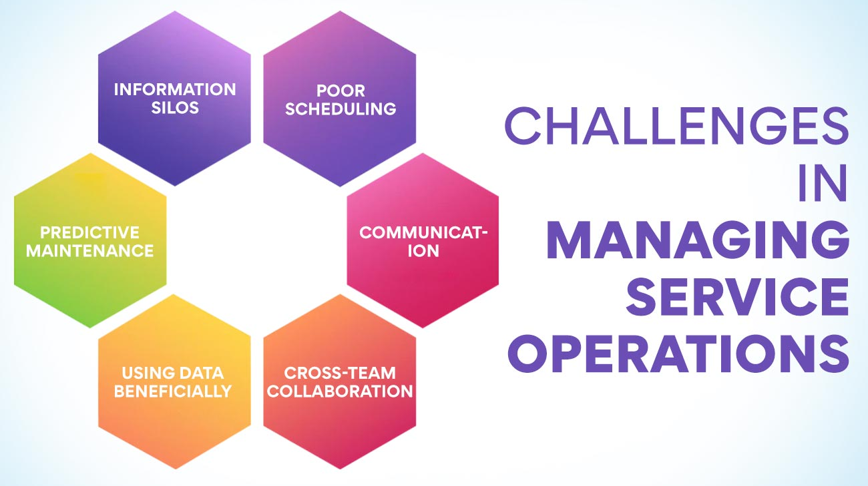

Slide 6
Service Operations Management Selected Issues
New service development
Managing service experiences
Front-office/Back-office
Analyzing processes
Service quality
Yield management
Inventory management
Waiting time management

Slide 7
New Service Development
Service Blueprinting
Focus on moments of truth
Servicescapes
Utility-based Service Design
Perceived utility to customer
Relative importance of Dimensions of Service Quality

Slide 8
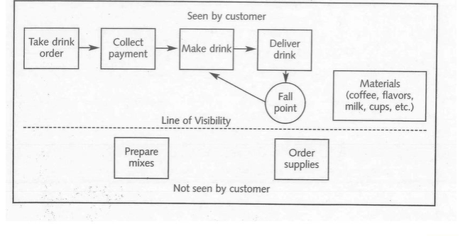

Slide 9
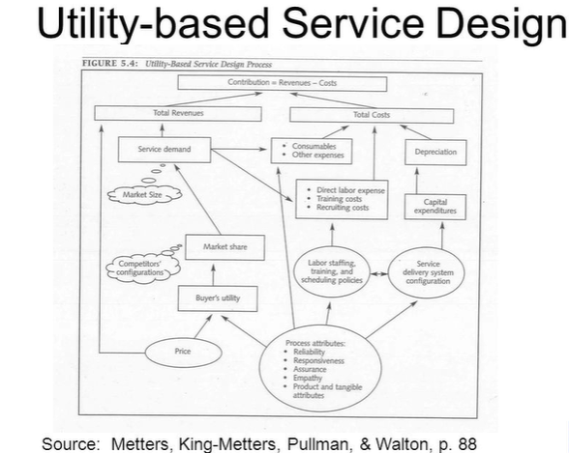

Slide 10
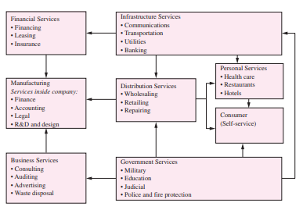
Role of services in an economy

Slide 11
Indian Service Sector
India has the fastest growing service sector in the whole world and India contributes about 66% to the Indian GDP.
Services trade accounts for nearly 40 percent of world trade.
The global services market size will grow from $13,978.41 billion in 2022 to $15,223.84 billion in 2023 at a compound annual growth rate (CAGR) of 8.9%.
The service sector includes services like, banking and finance, IT and Technology, energy sector, education, logistics, export and import, Media, health care, telecommunication, storage and communication, hotel Industries, legal and law industry, business services, etc.

Slide 12
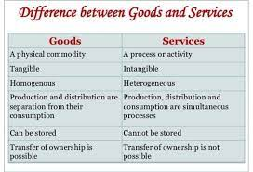
Nature of Services

Slide 13
Special characteristics of Services
Intangibility
Inseparability of production and consumption
Variability (variety/choice)
Perishability

Slide 14
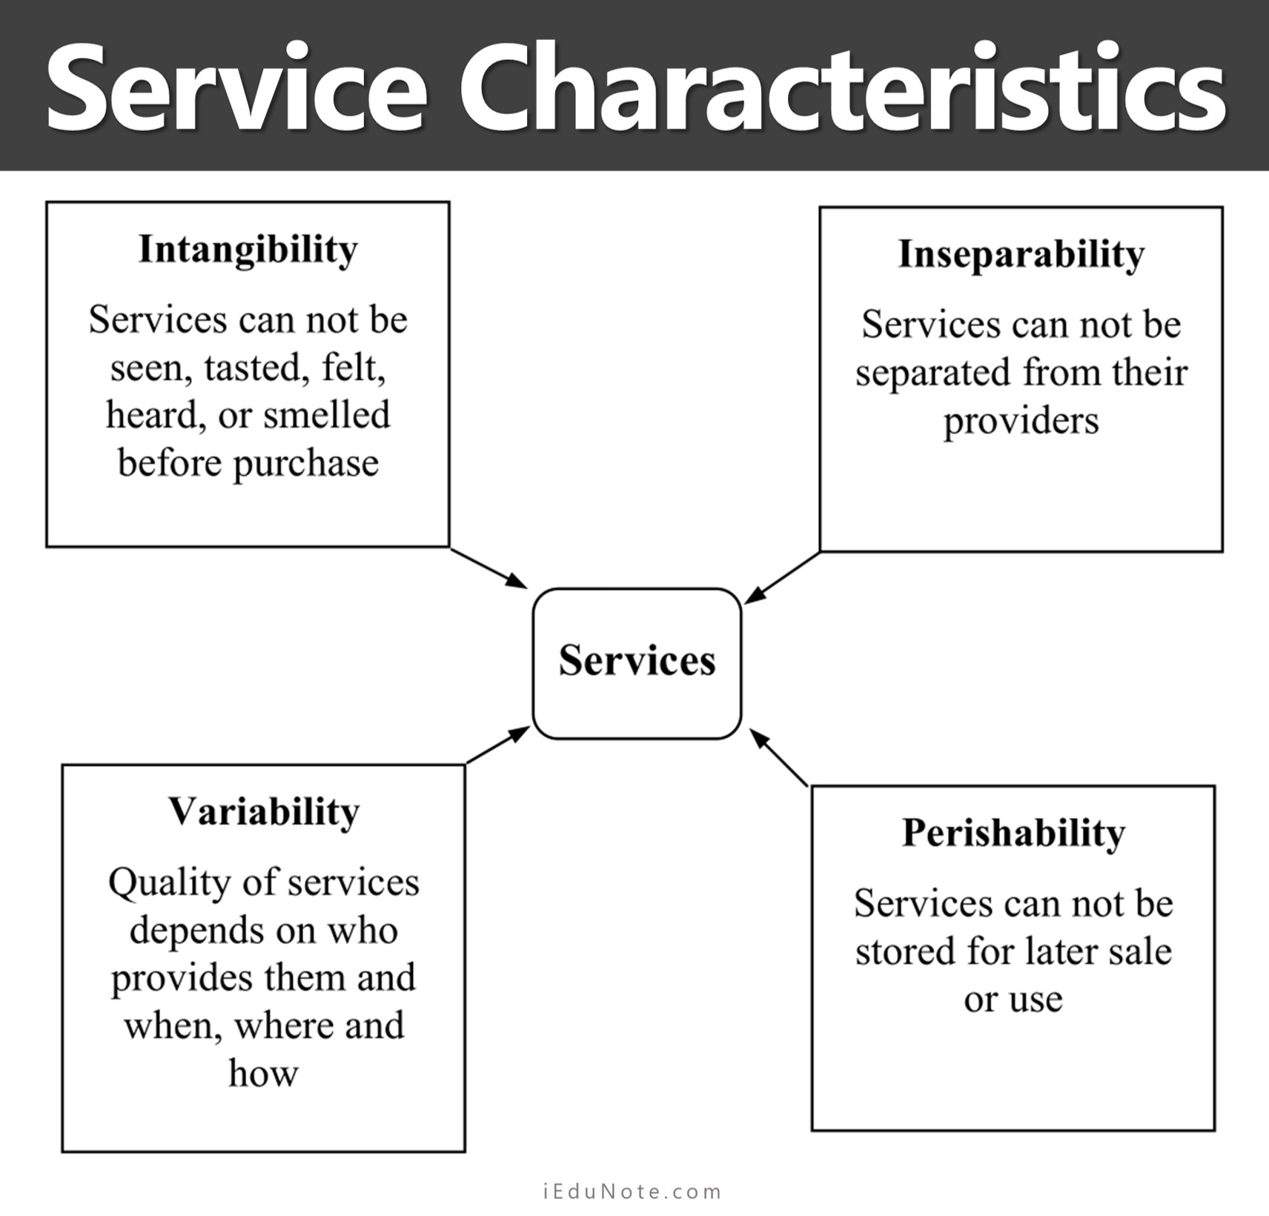

Slide 15
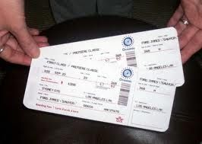

Lack of Ownership in Services
It refers to the fact that you cannot own and store a service like a product
Services are used or hired for a period of time.

Slide 16
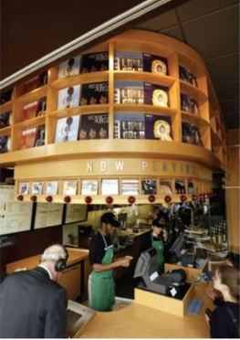
Intangibility of services
It refers to the total lack of perception of a service’s
characteristics before and (often) after it is performed.
The term was first used in 1963 (Regan)
It is the most radical characteristic of services ,
from which the others emanate.

Slide 17
Intangibility of services
Requires great marketing skills in ‘tangibilising’ intangible offerings, i.e in surrounding them with ‘hard’ peripheral attributes.
Technical superiority and long term vision in new service development, in order to protect a service from its non- patentability
Special pricing know-how, i.e what is the cost of a service?
Creative communication skills i.e what message to communicate?

Slide 18
Intangibility of services
Criticism to the distinguishing power of intangibility
Increasing knowledge and repeated use of services nullifies intangibility
The inability of customers to physically evaluate services is also the case in some goods.
Many goods have intangible elements too
Picture of beach
perceptions

Slide 19
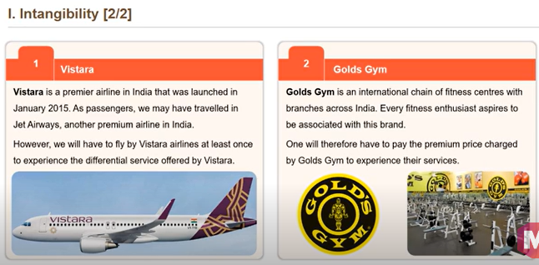

Slide 20
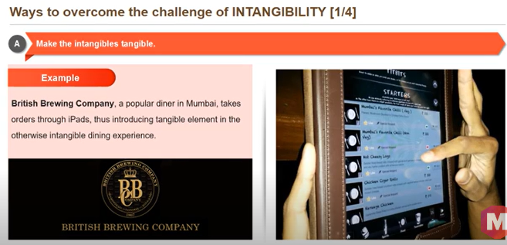

Slide 21
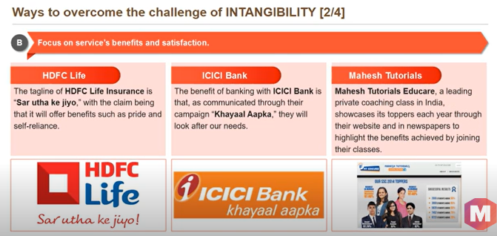

Slide 22
Inseparability of Services
The simultaneous production and consumption of services
The production process of services has been called “servuction” process (Eiglier and Langeard, 1977)
The customer is present when the service is produced.
The customer plays a role in the servuction and delivery process.
Customers interact with one another during the servuction process and may be affected (positively/negatively) by this interaction

Slide 23

Inseparability of Services
Implications:
Mass production of services is difficult
No significant economies can be earned from centralisation of operations, since the service must be produced at the convenience of customers.
Service quality depends highly on what happens in
real-time i.e during the service encounter.
Since customers have a vital role in the servuction
and delivery process, the service provider needs
great skills to train them how to play their role.
The service provider must prove excellence each
time the service is produced.
The service provider needs skills in order to tackle
disruptions

Slide 24
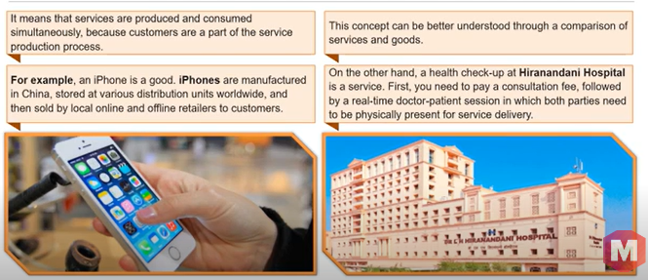

Slide 25
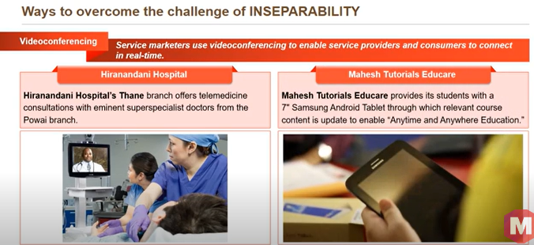

Slide 26
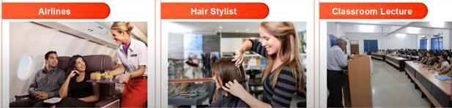
Heterogeneity
It is called inconsistency, variability or non-standardisation, because it makes it difficult to establish a standard.
This is because a service is delivered by different people with different delivery times and customer involvement levels.
The service quality experienced by a passenger while flying an airline will differ each time owing to the cabin crew, co-passengers, and travel time.
Similarly, hair stylist, a professor’s lecture may vary owing to the human element.

Slide 27
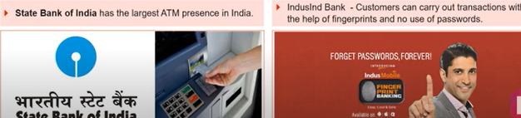
Ways to overcome heterogeneity
Train internal customers – Employees
Airlines standardise their service quality by training their cabin crew for three months in areas such as service delivery, in-flight safety, and passenger security.

Slide 28
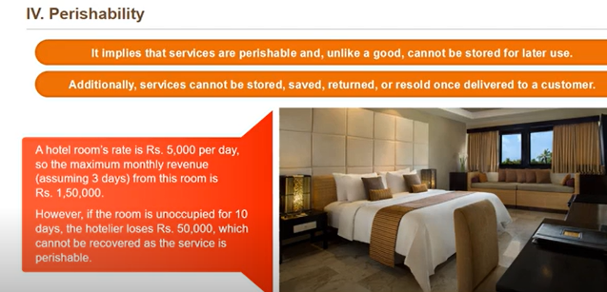

Slide 29
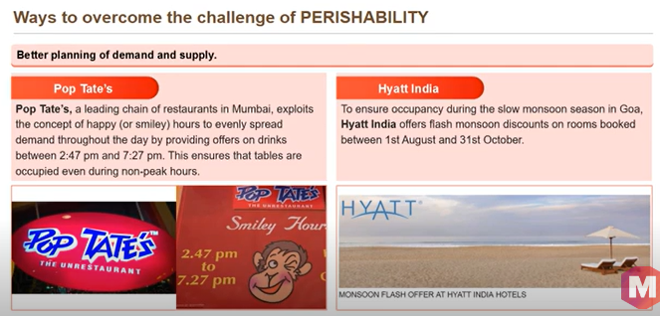

Slide 30
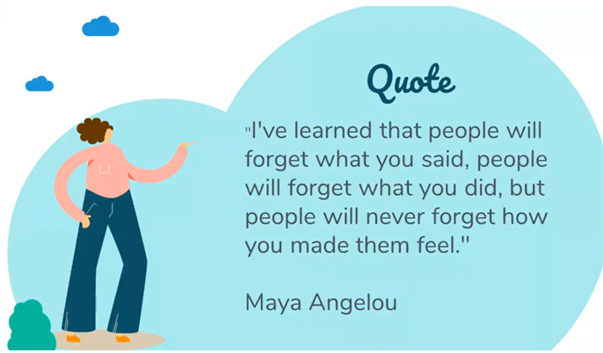

Slide 31
service encounter
A service encounter is defined as a moment when a customer interacts with a service or product for the first time. It is the customer's actual interaction with a service company. It is identified as a key component of the current agenda for service marketers. More than half of the world's multinational corporations employ in providing services, thus the scrutiny of service encounters is becoming increasingly significant.

Slide 32
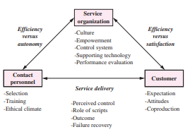
Service Encounter Triad

Slide 33
Types of Service Encounter
Remote Encounter:
Encounter can occur without any direct human contact is called as Remote Encounters. Such as, when a customer interacts with a bank through the ATM system, or with a mail-order service through automated dial-in ordering. Remote encounters also occur when the firm sends its billing statements or communicates other types of information to customers by mail. Although there is no direct human contact in these remote encounters, each represents an opportunity for a firm to reinforce or establish perceptions in the customer. In remote encounter the tangible evidence of the service and the quality of the technical process and system become the primary bases for judging quality. Services are being delivered through technology, particularly with the advent of Internet applications.
Retail purchases, airline ticketing, repair and maintenance trouble shooting, and package and shipment tracking are just a few examples of services available via the Internet.

Slide 34
Types of Service Encounter
Phone Encounters:-
In many organizations, the most frequent type of encounter between a customer and the firm occurs over the telephone is called as phone encounter.
Almost all firms (whether goods manufacturers or service businesses) rely on phone encounters in the form of customer-service, general inquiry, or order-taking functions. The judgment of quality in phone encounters is different from remote encounters because there is greater potential variability in the interaction.
Tone of voice, employee knowledge and effectiveness/efficiency in handling customer issues
become important criteria for judging quality in these encounters.

Slide 35
Types of Service Encounter
Face-to-Face Encounters: A third type of encounter is the one that occurs between an employee and a customer in direct contact is called as Face-to-Face Encounter. In a hotel, face–to–face encounters occurs between customers and maintenance personnel, receptionist, bellboy, food and beverage servers and others.
Determining and understanding service quality issues in face–to–face context is the most complex of all. Both verbal and non-verbal behaviors are important determinants of quality, as are tangible cues such as employee dress and other symbol of service (equipment’s, informational brochures, physical settings).
In face–to–face encounters the customer also play an important role in creating quality service for herself through his/her own behavior during the interaction. For example, at Disney themeparks, face-to-face encounters occur between customer and ticket-takers, maintenance personnel, actors in Disney character costumes, ride personnel, food and beverage servers, and others. For a company such as,IBM, in a business-to-business setting direct encounters occur between the business customers and salespeople, delivery personnel, maintenance representatives, and professional consultants.

Slide 36
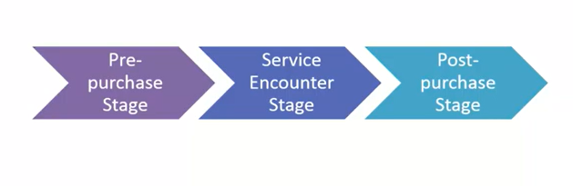
Three stages in the service consumption

Slide 37
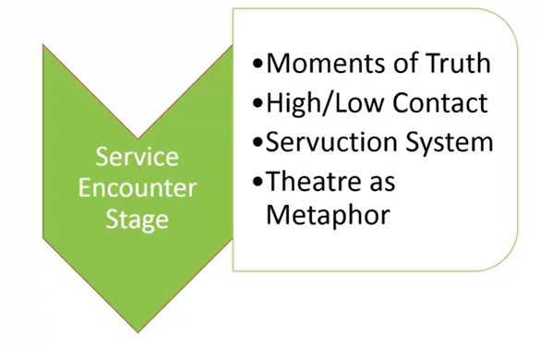
Encounter stage

Slide 38
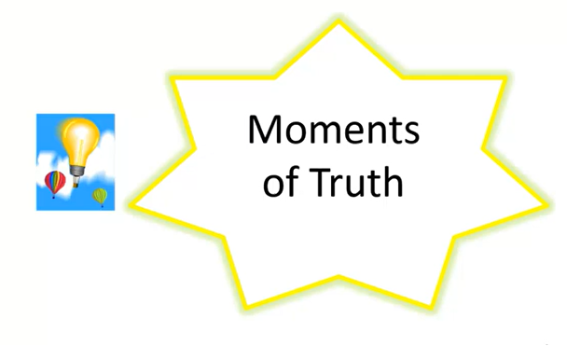
Moments of Truth

Slide 39
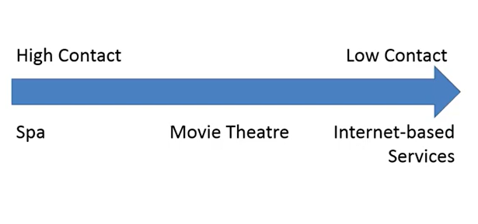
Levels of service contact

Slide 40
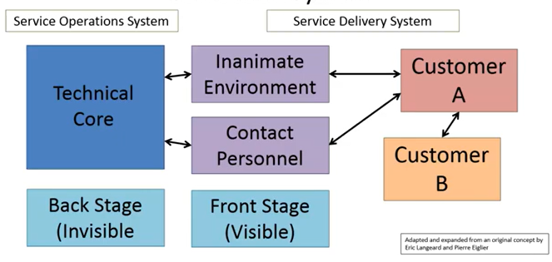
Servuction System

Slide 41
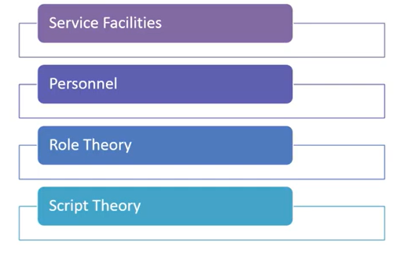
Theatre as a Metaphor

Slide 42
Service Operations
Service operations are a company's infrastructure when optimizing their customers' experience. This often involves creating customer service, customer success, customer experience, and customer support teams to improve the company's level of service and reach business goals. Service operations might comprise a larger group of people, and some companies may employ operations specialists or managers to oversee customer service processes.

Slide 43
What do service operations do?
Analyze metrics - This commonly involves reviewing the results of customer satisfaction surveys to learn about their experiences with employees and products. They can also determine a strategy that may help improve overall scores to increase revenue. This can involve managing customer data, including purchase amounts, repeat business, and upselling.
Review processes and platforms - Operations professionals often review the internal processes, systems, and platforms employees use to identify areas for improvement.
Onboard customers - This might involve customer education and working with customer service managers to help engage consumers in programs like rewards or loyalty programs. Service operations teams can also collaborate with sales and customer service teams to help ensure they have access to information they might require to onboard customers, like names, shopping history, and contact information.

Slide 44
Gather team feedback - Service operations teams also gather internal feedback. These might be their thoughts on how to improve customer relationships, how a company can improve their processes, or what tools they use to perform their jobs better.

Slide 45
Service Package
Service organizations sell bundle of goods and services. Any service bundles composed of explicit physical items having sensual benefits and implicit intangibles having psychological benefits which is better represented with the help of service package.

Slide 46
Service Package
1. Supporting facility. The physical resources that must be in place before a service can be offered. Examples are a golf course, a ski lift, a hospital, and an airplane.
2. Facilitating goods. The material purchased or consumed by the buyer, or the items provided by the customer. Examples are golf clubs, skis, food items, replacement auto parts, legal documents, and medical supplies.
3. Information. Data that is available from the customer or provider to enable efficient and customized service. Examples include electronic patient medical records, airline Web site showing seats available on a flight, customer preferences from prior visits, GPS location of customer to dispatch a taxi, and Google map link on a hotel Web site.
4. Explicit services. The benefits that are readily observable by the senses and that consist of the essential or intrinsic features of the service. Examples are the absence ofpain after a tooth is repaired, a smooth-running automobile after a tuneup, and the response time of a fire department.
5. Implicit services. Psychological benefits that the customer may sense only vaguely, or the extrinsic features of the service. Examples are the status of a degree from an Ivy League school, the privacy of a loan office, and worry-free auto repair.

Slide 47
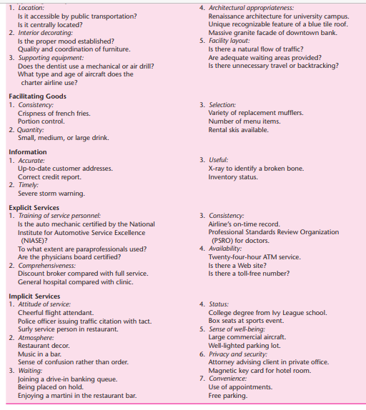
Criteria for Evaluating the Service Package
Supporting Facility

Slide 48
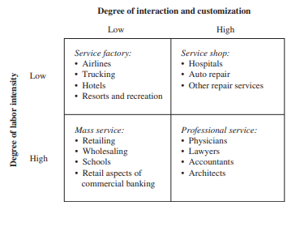
The Service Process Matrix

Slide 49
Service Process Matrix
Service factories provide a standardized service with high capital investment, much like a line-flow manufacturing plant.
Service shops permit more service customization, but they do so in a high-capital environment.
Customers of a mass service will receive an undifferentiated service in a labor-intensive environment,
but those seeking a professional service will be given individual attention by highly trained specialists

Slide 50
Service Process Matrix
The vertical dimension measures the degree of labor intensity, which is defined as the ratio of labor cost to capital cost.
Thus, capital-intensive services such as airlines and hospitals are found in the upper row because of their considerable investment in plant and equipment relative to labor costs. Labor-intensive services such as schools and legal assistance are found in the bottom row because their labor costs are high relative to their capital requirements.

Slide 51
Service Process Matrix
The horizontal dimension measures the degree of customer interaction and customization, which is a marketing variable that describes the ability of the customer to affect personally the nature of the service being delivered. Little interaction between customer and service provider is needed when the service is standardized rather than customized.
For example, a meal at McDonald’s, which is assembled from prepared items, is low in customization and served with little interaction occurring between the customer and the service providers. In contrast, a doctor and patient must interact fully in the diagnostic and treatment phases to achieve satisfactory results. Patients also expect to be treated as individuals and wish to receive medical care that is customized to their particular needs.

Slide 52
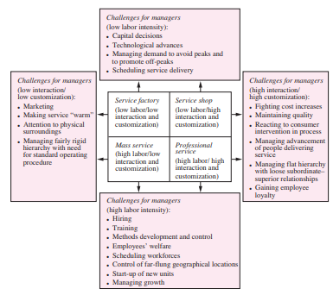
Challenges for Service Managers

Slide 53
Services with high capital requirements (i.e., low labor intensity), such as airlines and hospitals, require close monitoring of technological advances to remain competitive

Slide 54
Frameworks for Designing Service Operation Systems
Service Design Framework (SDF)
Developed by the Service Design Network, the SDF is a holistic framework that emphasizes user experience throughout the service lifecycle. It consists of five stages:
Discover: Understand user needs and context.
Define: Define the service concept and value proposition.
Develop: Design and prototype the service experience.
Deliver: Implement and launch the service.
Improve: Continuously monitor and improve the service.

Slide 55
Service Design Framework (SDF)
Discover:
In this stage, the focus is on understanding user needs and the context in which the service operates. This involves extensive research to gain insights into the target audience, their behaviors, and their expectations. Eg: Airbnb extensively researched user needs and behaviors to understand what travelers and hosts valued in the accommodation-sharing experience. This research helped Airbnb discover the desire for unique and personalized stays.
Define:
Once user insights are gathered, the next step is to define the service concept and value proposition. This stage involves clarifying the purpose and unique value that the service will provide to its users.
Eg: Apple's definition of the iPhone's service concept and value proposition centered on simplicity, innovation, and a seamless user experience. The company aimed to provide a device that seamlessly integrated communication, entertainment, and productivity.

Slide 56
Service Design Framework (SDF)
Develop:
In the development stage, service designers create and prototype the service experience. This includes designing the service's various touchpoints, such as digital interfaces or physical interactions, to ensure a seamless and user-friendly experience. Eg: Google's development of its search engine involved designing a simple and intuitive interface for users to find information quickly. Google continuo
Deliver:
The deliver stage focuses on the implementation and launch of the service. It involves putting the designed service into action and making it accessible to users. Implementation strategies, communication plans, and operational considerations are crucial during this phase. Eg: Amazon's implementation of its Prime service involved not only delivering products quickly but also offering additional services like streaming and exclusive deals. The delivery aspect is not just about physical goods but also about providing a comprehensive service ecosystem.

Slide 57
Service Design Framework (SDF)
Improve:
The final stage, improve, emphasizes continuous monitoring and enhancement of the service. Feedback from users, as well as performance metrics, are collected and analyzed to identify areas for improvement. Service designers then iterate on the design to make the service even more effective and user-centric.
Eg: Spotify continuously improves its music streaming service based on user feedback and data analytics. Features such as personalized playlists, recommendations, and interface enhancements are regularly updated to keep the service relevant and enjoyable for users.

Slide 58
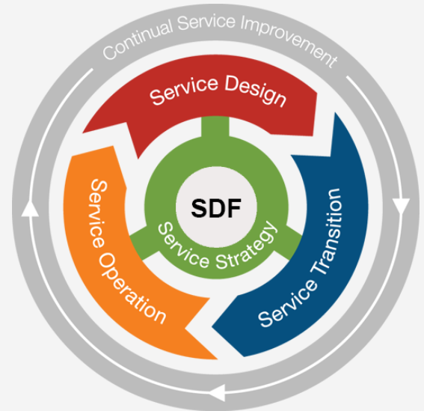
ITIL Service Lifecycle (ITIL)

Slide 59
ITIL Service Lifecycle (ITIL)
ITIL is a widely used framework for managing IT services. It provides a set of best practices for service design, delivery, operation, and continuous improvement. ITIL consists of five core stages:
Service Strategy: Define the service strategy and vision.
Service Design: Design and develop new or improved services.
Service Transition: Transition new or changed services into production.
Service Operation: Deliver and operate services on a day-to-day basis.
Continual Service Improvement (CSI): Continuously improve the quality of services.

Slide 60
DevOps Framework
DevOps is a culture and set of practices that aims to bridge the gap between development and operations teams. It emphasizes collaboration, automation, and continuous delivery to improve the speed and quality of service delivery. The DevOps framework includes several key principles, such as:
Infrastructure as Code: Treat infrastructure as code to automate provisioning and configuration.
Continuous Integration and Continuous Delivery (CI/CD): Automate the build, test, and deployment of code changes.
Monitoring and Feedback: Continuously monitor performance and gather feedback to identify and resolve issues.

Slide 61
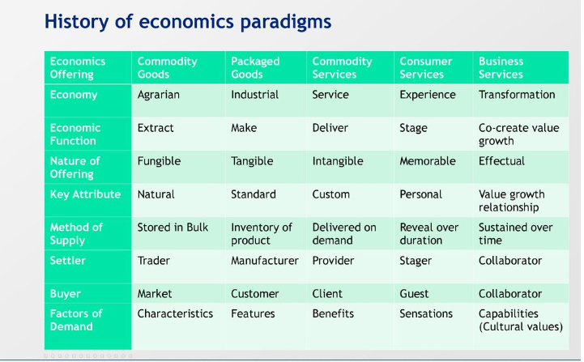

Slide 62
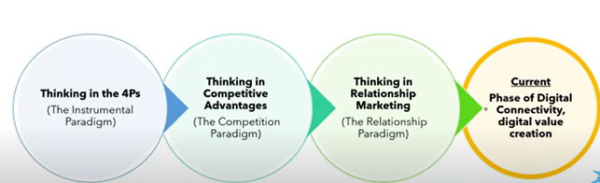
Crucial Milestones

Slide 63
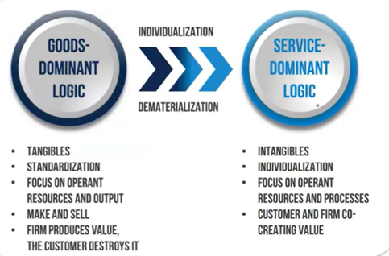
GDL - SDL

Slide 64
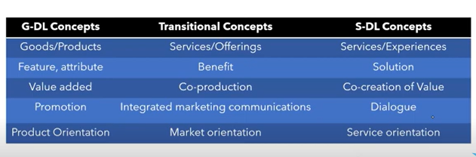
Transitioning from GDL - SDL

Slide 65
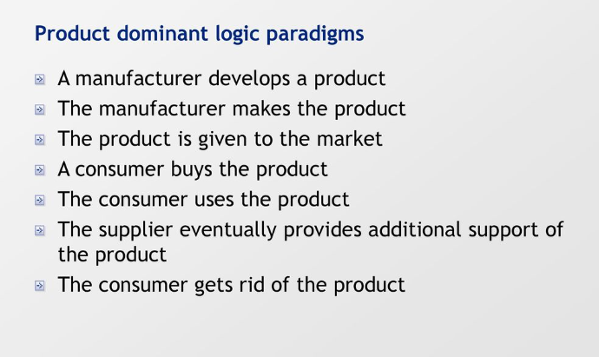

Slide 66
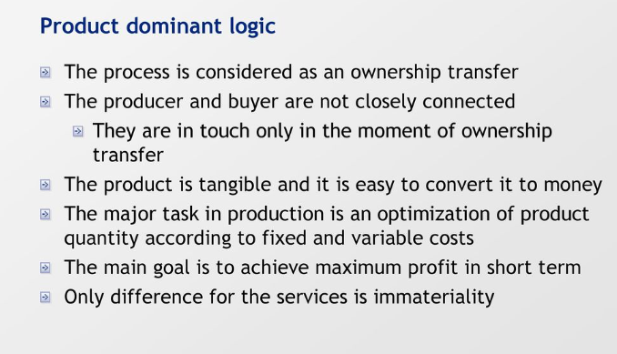

Slide 67
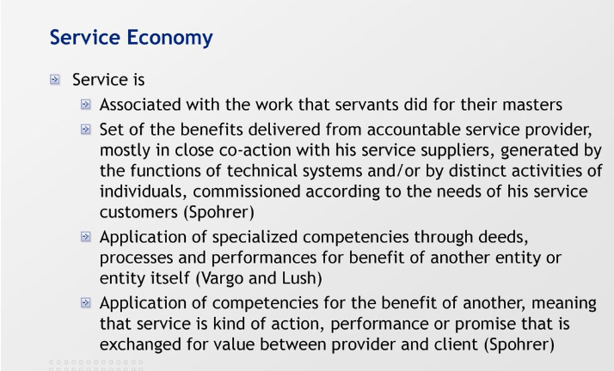

Slide 68
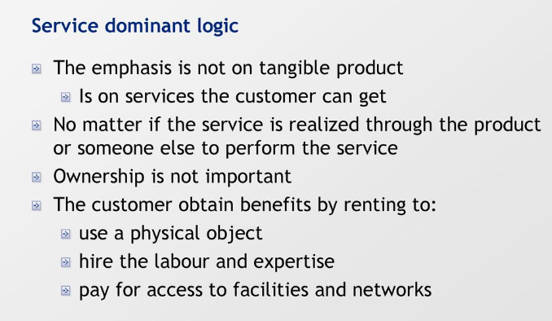

Slide 69
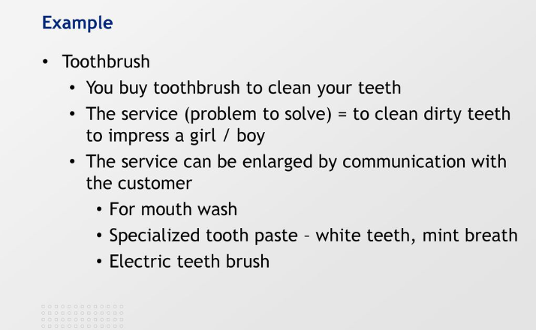

Slide 70
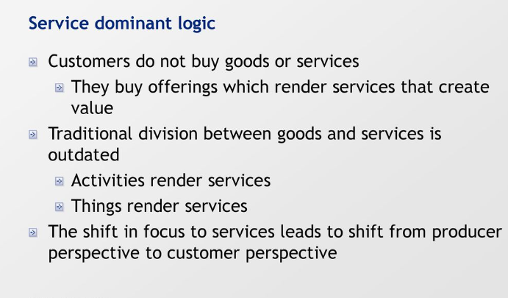

Slide 71
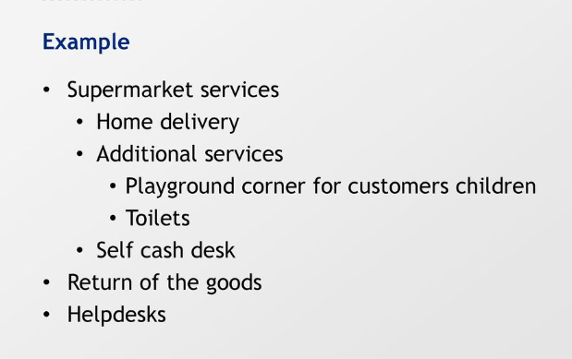

Slide 72
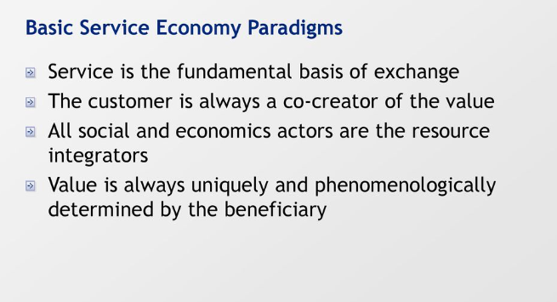

Slide 73
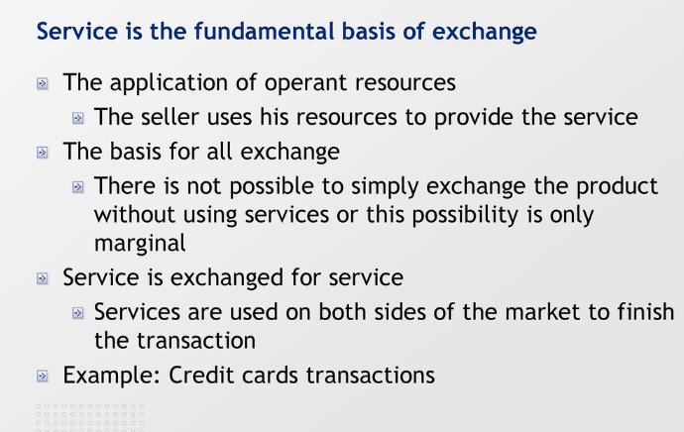

Slide 74
